Slide 1
Hazards..
Section 4.5 to 4.8

Slide 2
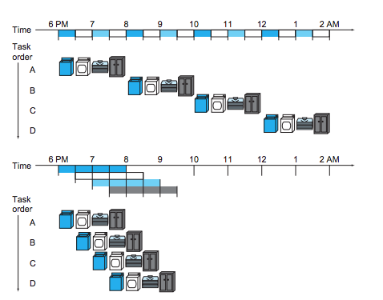
Review pipeline

Slide 3
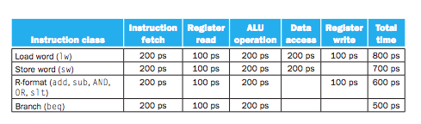
Performance

Slide 4
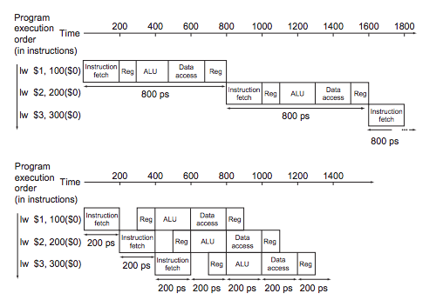
Performance

Slide 5
What is hazards
Situations in the pipelining
Next instruction cannot execute in the following clock cycle
Three Types
Structural Hazard
Data Hazards
Control Hazards

Slide 6
Structural Hazard
Hardware can not support the combination of instructions
In the same cycle
Example: washer/dryer same machine
Friend is busy
MIPS has no structural hazard
Combining IM and DM can generate structural hazard

Slide 7
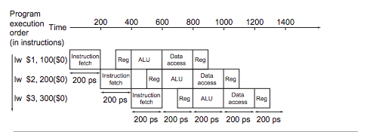
Structural Hazard ………

Slide 8
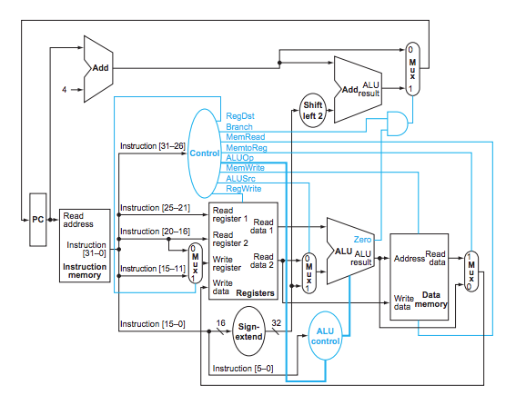
Structural Hazard ………

Slide 9
Data Hazard
Instruction can not execute in the proper clock cycle
Data is not available
Example: Socks missing
Add $s0, $t0, $t1
Sub $t2, $s0, $t3

Slide 10
Solve Data Hazard
Depend on compiler
Not feasible

Slide 11
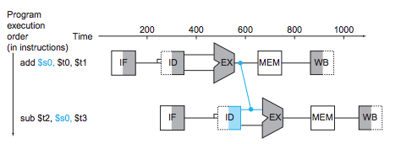
Solve Data Hazard
Forwarding or bypassing
By adding extra hardware

Slide 12
Data Hazard- Stall
Does forwarding solves all the problem?
No
lw $s0, 32($t1)
sub $t2, $s0, $t3

Slide 13
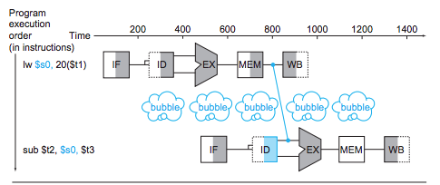
Pipeline stall or bubble

Slide 14
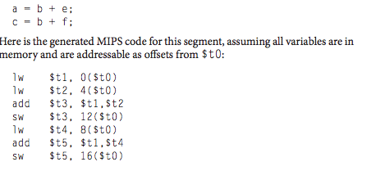
Solve Stall
Code reordering can resolve this issue

Slide 15
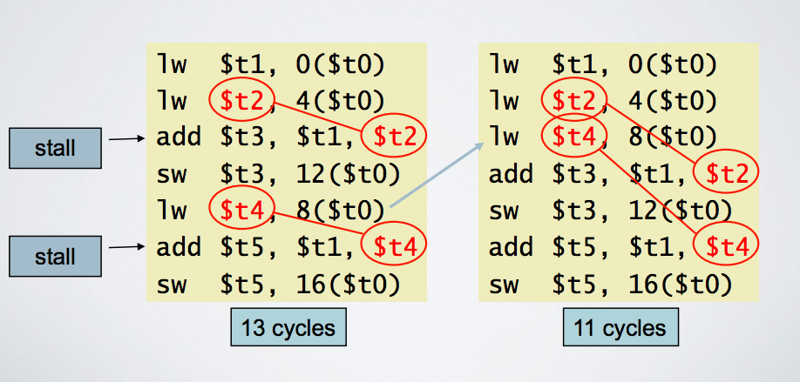
Code Scheduling Avoid Stalls

Slide 16
Control / Branch Hazard
Proper instruction can not execute in the proper clock cycle in pipeline
Instruction fetched wrong instruction
Example: Laundry -> specific setting required
Solutions:
Stall -- works but slow
Guess and let the second load running

Slide 17
Control / Branch Hazard
Equivalent Example: Brunch Instruction
Immediately we do not know what is the next instruction

Slide 18
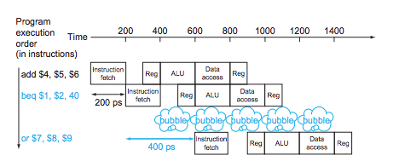
Control / Branch Hazard- stall
Solution one:

Slide 19
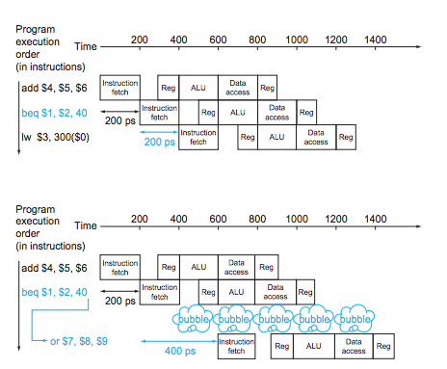
Control / Branch Hazard- predict (not taken)

Slide 20
Control / Branch Hazard- predict (taken)
Sophisticated branch prediction
end of the loop will jump back to the beginning of the loop
Dynamic prediction
Keep history

Slide 21
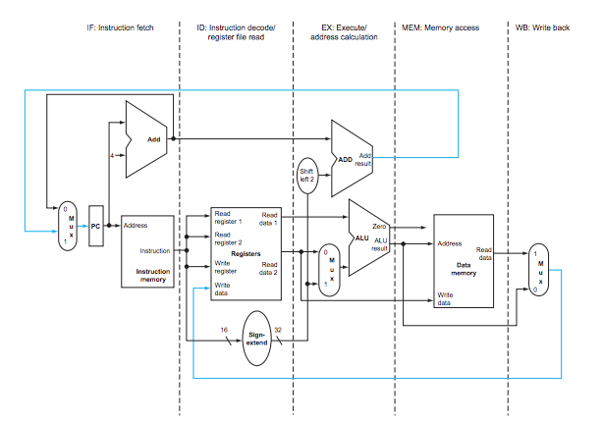
MIPS Pipeline Datapath
Notes:
Data passes from left to right except write back and pc increment. Write back can generate data hazards and pc could generate control hazard.

Slide 22
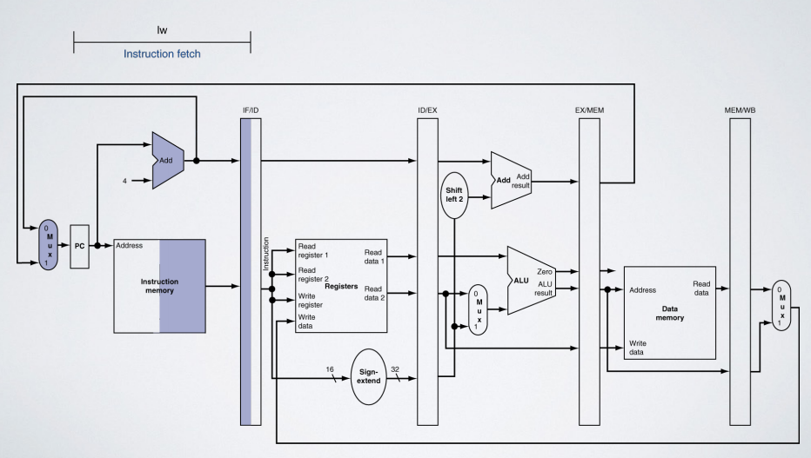
IF for Load, Store

Slide 23
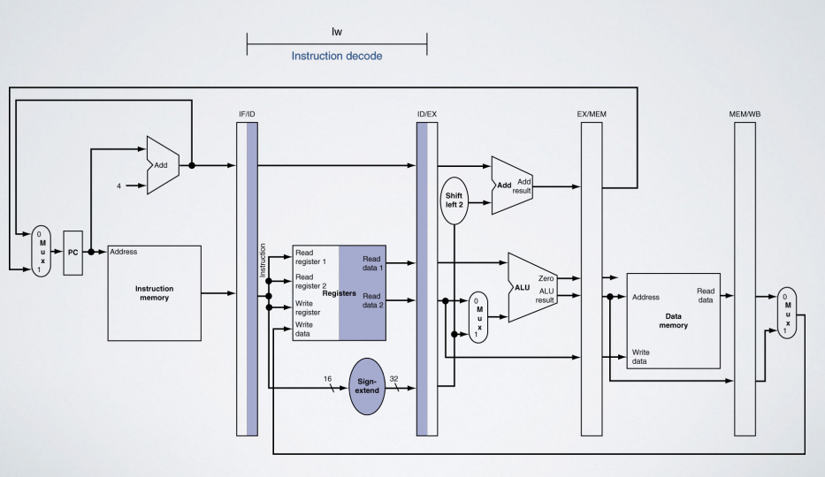
ID for Load, Store

Slide 24
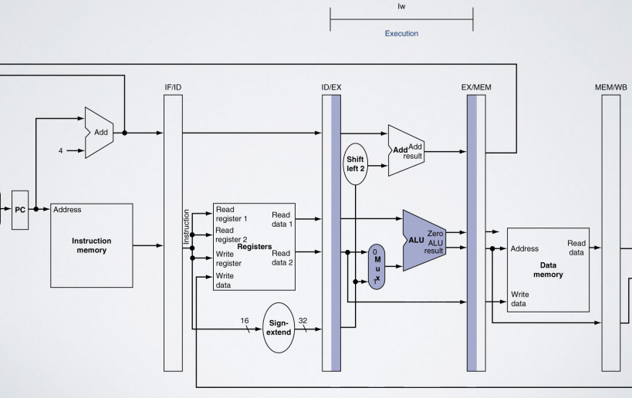
Ex for Load

Slide 25
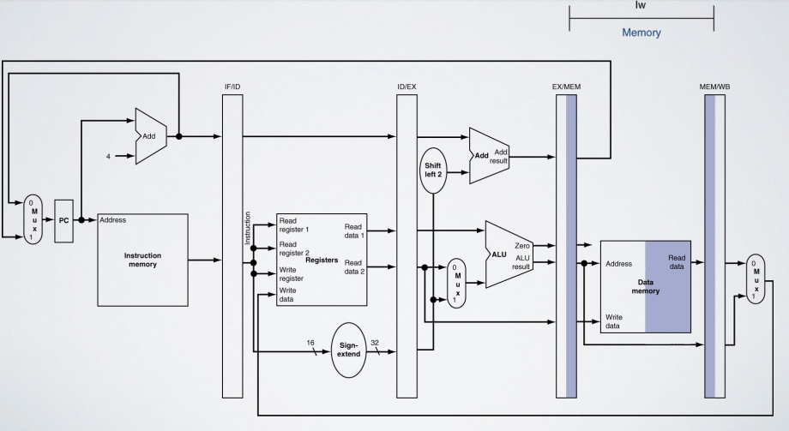
MEM for Load

Slide 26
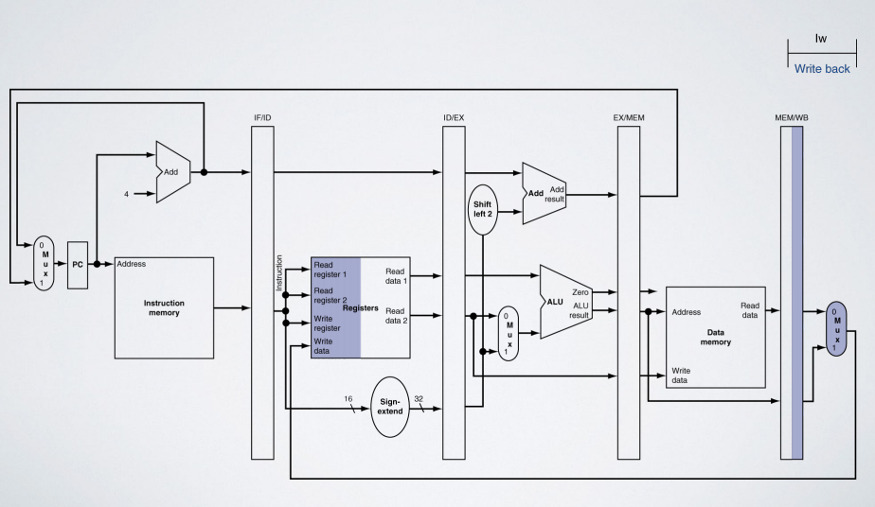
WB for Load

Slide 27
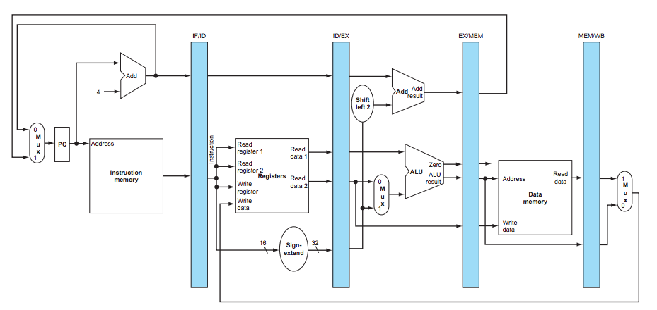
Incomplete Datapath

Slide 28
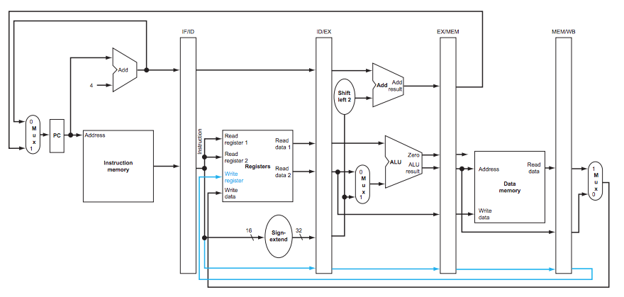
Complete Datapath

Slide 29
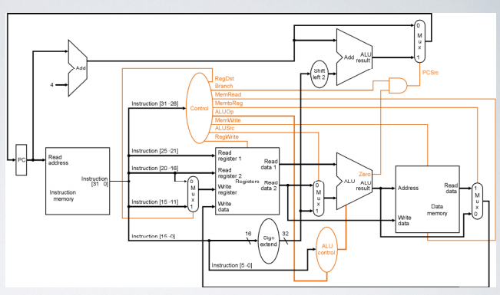
Controls…

Slide 30
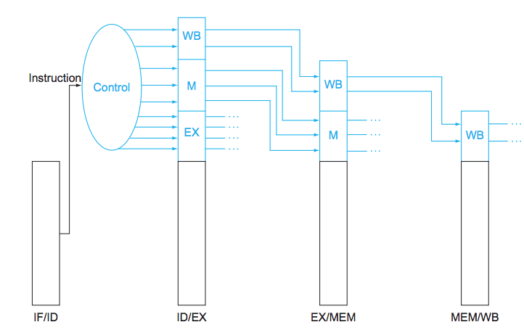
Control Path

Slide 31
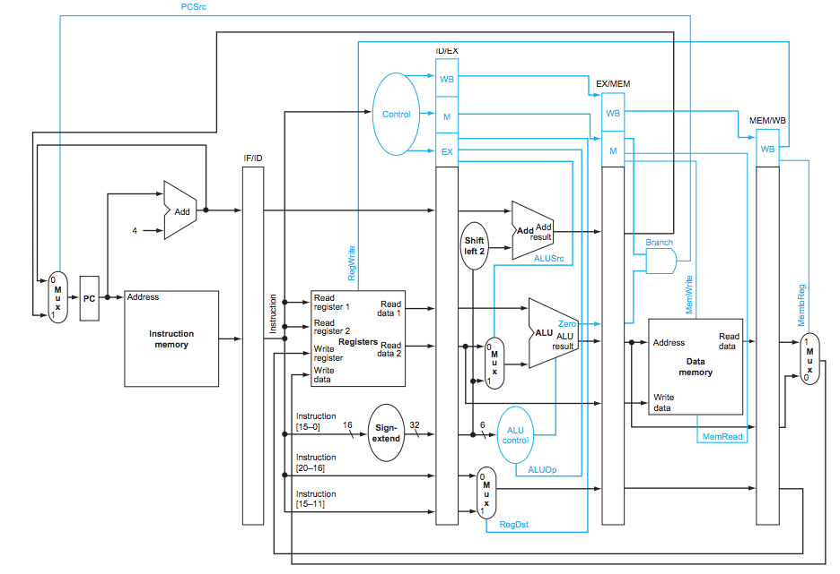
Control and Datapath

Slide 32
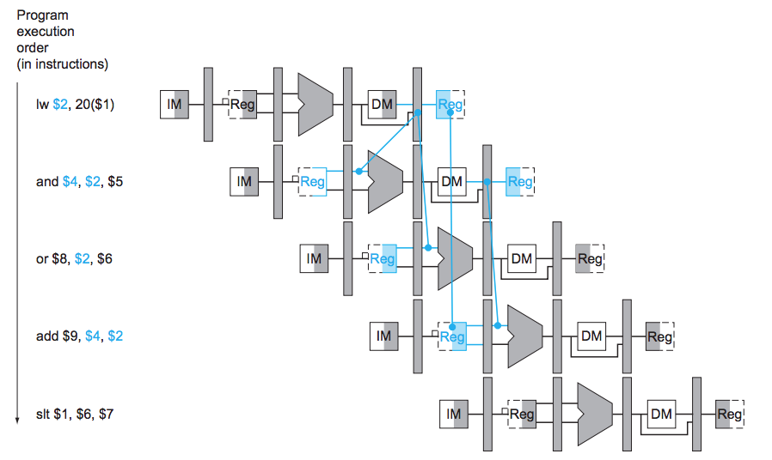
Hazard Detection

Slide 33
Hazard Detection

Slide 34
What we have covered
Section 4.6 - 4.8

